Slide 1
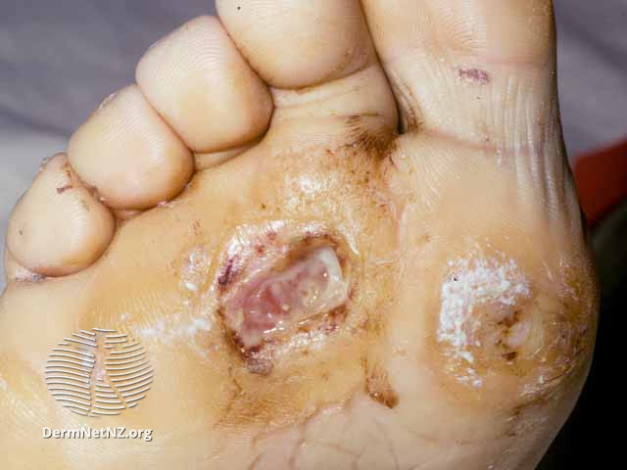
Figure 1: Mr. Cordero’s Foot Ulcer

Slide 2
Wound Location
Wound dimensions (height, width, surface area, depth)
Nature of the wound bed (necrotic/sloughy/granulating/epithelializing)
Volume of wound exudate (low/moderate/high)
Consistency of wound exudate (serous/purulent)
Wound margins (hyperkeratotic/rolled edges/undermined)
Pain
Presence of bony sequestrium or foreign bodies
Presence of infection
Condition of the peri-wound skin (e.g. macerated/dermatitis)
State of surrounding skin (e.g. erythema, inflammation)
Figure 2: ﻿Wound Characteristics

Slide 3
Clinical observation for signs of arterial insufficiency
Doppler assessment
Can identify the presence or absence of arterial disease in the diabetic foot. Useful for finding nonpalpable foot pulses. Can also provide information on strength and rhythm of the pulse and the extent of arterial disease
The signs include cold to touch and pale or cyanosed. Neuroischaemic foot ulcers frequently occur on the margins of the foot, on the toes, and under thickened toenails (subungual ulceration)
Ankle brachial pressure index
Palpation of foot pulses
Allows quantification of the vascular status of the diabetic foot and provides an objective measure of severity of vascular disease in the lower limb. This involves measuring systolic pressures in the upper and lower limbs and calculating a ratio
Palpation of foot pulses: dorsalis pedis and posterior tibial. Can be associated with arterial disease, however, usually does not provide sufficient information on patient’s vascular status and further investigation are needed
Figure 3: Elements of ﻿Vascular Status Assessment

Slide 4
Autonomic
Decreased activity of sweat glands in the feet
Visibly distended veins and dry skin (anhydrosis), which increases the risk of skin fissures
Sensory
Motor
Warm foot and pink in colour, palpable pulses
Burning pain in the foot or leg
Wasting of small intrinsic muscles
Frequent pain at night
Clawing of toes
Prominent metatarsal heads
Pain is not relived by rest
When this is coupled with sensory loss these areas become prime sites of tissue damage
Figure 4: Elements of ﻿Neurological Status Assessment

Slide 5
Cellulitis
Lymphangitis
Phlegmon
Purulent Exudate
Pus/abscess
Crepitus in the joint
Erythema
Increase in exudate volume
Localized pain in normally insensate (neuropathic) foot
Malodour
Probe to bone
Figure 5: Criteria for Identifying Infection in Diabetic Foot Ulcers

Slide 6
Podiatrist
Pharmacist
Mechanical control of foot function and offloading of pressure with provision of specialist footwear and insoles.
Overseeing of pharmacological agents, appropriate dosing and interactions between different medications.
Wound care nurses
Dietician
Wound control, with the use of managed wound dressing products appropriate to the stage of the wound.
Modification of diet to optimize glycemic status.
Physician
Patient
Microbiological control, with the use of wound dressing products, superficial and deep wound swabbing and the provision of antibiotic therapy and lifestyle changes (smoking cessation, increased activity and diet modifications).
Self-monitoring and maintenance of glucose levels within narrow parameters
of good control.
Figure 6: Interprofessional Team Members Involved in the Care of Patients with Diabetes

Slide 7
T
Tissue management
Assess the amount of viable and nonviable tissue. Necrotic tissue and slough can delay wound healing so wound debridement should be undertaken to facilitate healing.
I
Inflammation and infection control
Diabetic foot ulcers are prone to bacterial and fungal infection. Steps should be taken to minimize infection risk.
M
Moisture balance
Exudate assessment is an important aspect of wound assessment to ensure that the moisture balance is achieved.
E
Epithelial (edge) advancement
It is used to achieve closure of diabetic foot ulcers and can be delayed due to the presence of callus. Frequent debridement of calluses is essential to promote healing.
Figure 7: Interprofessional Team Members Involved in the Care of Patients with Diabetes

Slide 8
Stage 1 Diagnosis of Diabetic Foot Ulcer (day 1)
Action point 1- complete ulcer matrix / validated scale and digital photo
Action point 2- check last diabetic assessment for risk factors. If new patient, perform foot assessment. If 1 year or older, perform reassessment
Action point 3- establish and document aetiology and address
*neuropathic go to stage 1a, neuroischaemic go to stage 1b
Action point 4- complete management plan and health outcome measures
Action point 5- treat/dress ulcer and review appt no longer than 7 days (SOS/24h appt/A&E contact card always offered as standard)
Go to stage 2 categorized as a, b, c, d and act accordingly
Stage 1a Neuropathic Diabetic Foot Ulcer
Employ/organize offloading strategies. Go to stage 2
Stage 1b Neuroischaemic Diabetic Foot Ulcer
Employ/organize offloading strategies + further vascular assessments, e.g. ABPI or refer to vascular team. Go to stage 2
Stage 2a Infected Diabetic Foot Ulcer
Deep and superficial swab, contact GP / consultant request broad spectrum oral antibiotics 7-14 days duration. If deep infected, consider admission and IV antibiotics, return appt max 3 days. Go to stage 3
Stage 2c Suspected osteomyelitis
Deep and superficial swab, contact GP / consultant request antibiotics, min 14 days. If severe, consider admission and IV antibiotics, return appt max 3 days . Go to stage 3 and contact X-ray
Stage 2d Suspected Charcot
Refer for X-ray, refer for immobilization of the affected joint and long-term management of offloading. Go to stage 3
Stage 2b Noninfected Diabetic Foot Ulcer
Return podiatry appt max 7 days. Go to stage 3
Stage 1 Evaluation of Ulcer (day 3-7)
Action point 1- review progress from stage 2 a/b/c/d
Action point 2- review ulcer matrix / scale and digital photo note improvement go to stage 4b / stasis or deterioration go to stage 4a
Action point 3- review initial aetiological factors assess for resolution and identify if any new issues to be addressed
Action point 4- review health outcome measures from management plan
Action point 5- treat/dress ulcer and review podiatry appt max 7 days if noninfected, if remains infected max 3 days
Stage 4a Diabetic Foot Ulcer Deterioration or Stasis
If infected obtain microbiology results and amend or add antibiotics if necessary. Review dressing regime + management plan. Obtain HbA1c level and refer to GP or diabetologist
Stage 4b Diabetic Foot Ulcer Improvement
Continue with current management plan. Go to stage 5
Stage 6 Diabetic Foot Ulcer Management Plan Evaluation (day 21)
Action as follows:
Assessment + risk factors check if these have been actioned
Check communication + referrals have been actioned
Check treatment interventions have been actioned
Continue cycle stages 1-6 until healing occurs
Stage 5 Evaluation of Ulcer Healing (day 14)
Action point 1- review progress from stage 2 a/b/c/d
Action point 2- review ulcer matrix / scale note improvement / stasis or deterioration and digital photo
Action point 3- review aetiological factors assess for resolution and action as appropriate
Action point 4- review health outcome measures from management plan
Action point 5- treat/dress ulcer and review podiatry appt max 7 days if noninfected, if remains infected max 3 days. Go to stage 6
Figure 8: Suggested Protocol for Diabetic Foot Ulcer Management

Slide 9
A
Ask
Ask the patient about comorbidities, medications, nutritional status and social history. Encourage the patient to vocalize their concerns.
L
Look
Look at the skin. Scrutinize the surrounding tissues to spot early or established skin changes
E
Examine
Examine for signs of infection.
R
Review
Review previous treatment and treatment notes.
T
Think
Think about an individualized management plan.
Figure 9: ALERT Assessment Framework

